Slide 1

Legal Issues 101
State Engineer and de novo Review Proceedings
What you need to know to follow what’s going on in the agency and at court
Julie Valdes, Assistant Attorney General
Water Users Workshops
March 21, 2017

Slide 2

Application Process Overview
Submit
Advertise/Protests
Hearing
Evaluate
Order
Reconsideration?
De novo review?

Slide 3
Legal Issues
Who Persuades?
Who Produces Evidence?
How much Evidence?
What’s a Rebuttable Presumption?
Notes:
Quote Searle and 73-3-3 for Burden info

Slide 4
Evidentiary Standards
Beyond a Reasonable Doubt (Near Certainty)
Clear and Convincing (Substantially More Likely True)
Preponderance 51/49 (More Likely True than Not)
Substantial Evidence (> scintilla; < preponderance)
Reason to Believe (same as “Probable Cause”)
Reasonable Suspicion (Low Standard)

Slide 5
  The Nuclear Power Plant Case
  HEAL Utah v. Kane County Water Conservancy Dist. et al., 2016 UT App 153

Slide 6
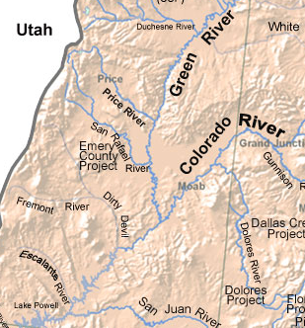

Slide 7
What is a rebuttable resumption?

Slide 8





Rebuttable Presumption

Slide 9
UCA 73-3-8(6)(c)
There is a rebuttable presumption of quantity impairment, as defined in Subsection 73-3-3(1), to the extent that, for a period of at least seven consecutive years, a portion of the right identified in a change application has not been:
(A) diverted from the approved point of diversion; and
(B) beneficially used at the approved place of use.

Slide 10

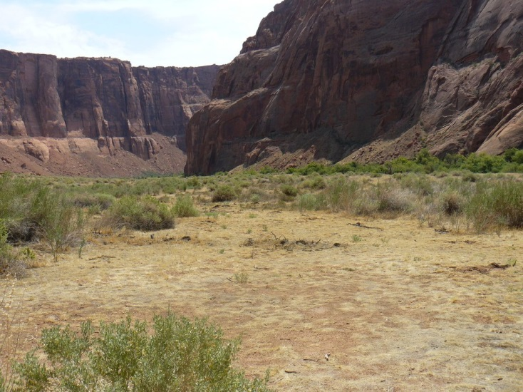


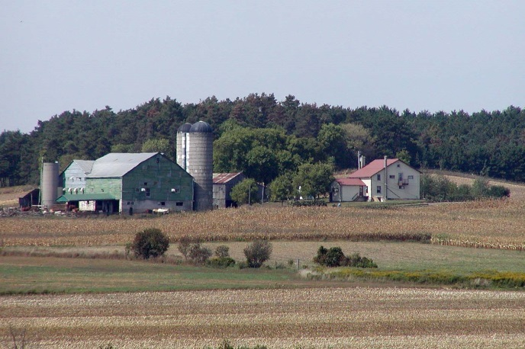

Quantity
Impairment

Slide 11
Other Reasons to Excuse Non-Use
(UCA 73-3-8(6)(c)(ii))
“source fails to yield sufficient water”
“water is unavailable because of the water right’s priority date”
public water supplier’s future requirements

Slide 12
Questions?
Thank you.

Slide 13
UCA 73-3-3(5)
“In a proceeding before the state engineer, the applicant has the burden of producing evidence sufficient to support a reasonable belief that the change can be made in compliance with this section [73-3-3] and Section 73-3-8, including evidence:
that the change will not cause . . . quantity impairment; or
if applicable, rebutting the presumption of [QI] described in Subsection 73-3-8(6)(c).”
(emphasis supplied)

Slide 14
UCA 73-3-3(1)(c)(i)
“Quantity impairment” means any reduction in the amount of water a person is able to receive in order to satisfy an existing right to the use of water that would result from an action proposed in a change application, including:
Diminishing the quantity of water in the source of supply for the existing right;
a change in the timing of availability of water . . .; or
enlarging the quantity of water depleted by the nature of the proposed use when compared with the nature of the currently approved use.
[It does not mean a change in the aquifer level.]

